Slide 1
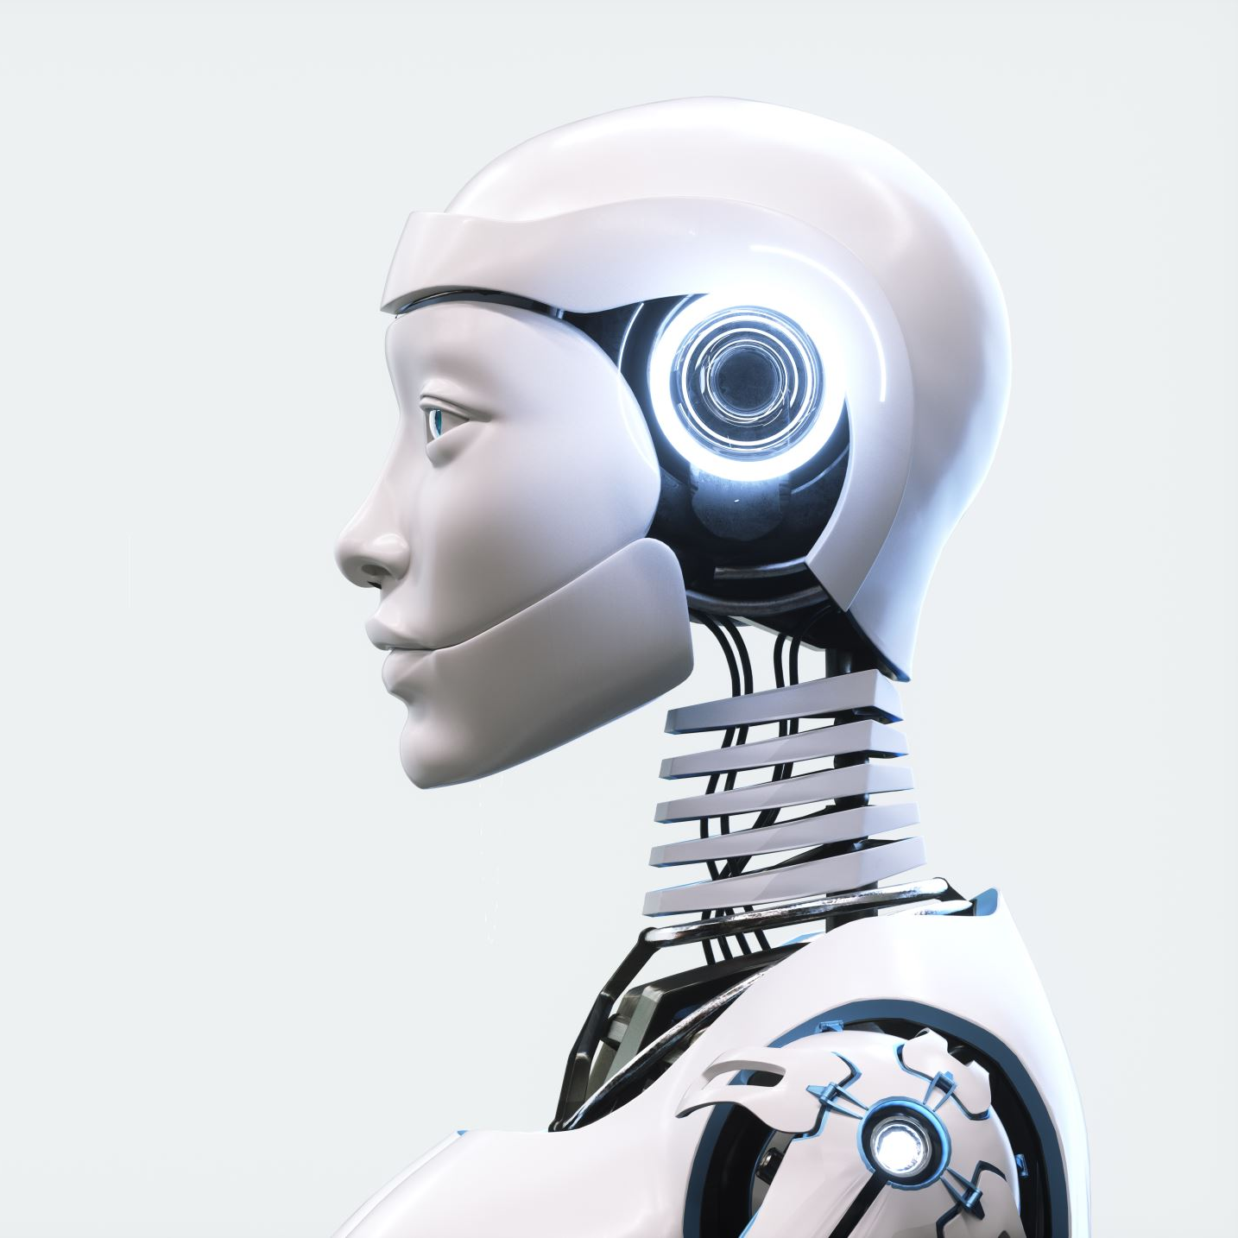
Robotics & Artificial Intelligence
Laboratory Setup
Team:
Pankaj Shelar
Chaitanya Parekh

Slide 2
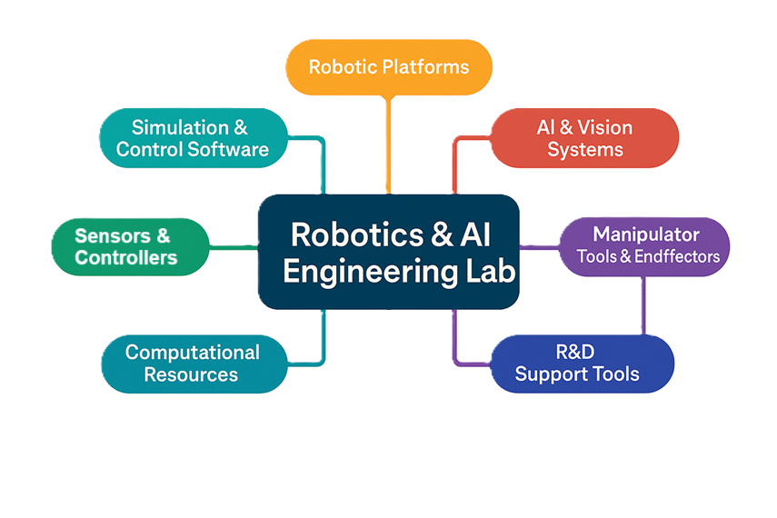
Flow chart

Slide 3
Robotic platform
Type | Example | Application
Mobile Robots | TurtleBot 3, Clearpath Jackal | Navigation, SLAM, AI path planning
Humanoid Robots | NAO, Pepper, Robotis OP3 | Human interaction, AI-based behavior modeling
Manipulator Arms | UR5, DOBOT Magician, Kinova Arm | Pick and place, kinematics, control algorithms
Drone | Drone assembly kit | Multi-agent coordination, decentralized AI

Slide 4
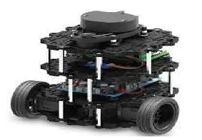
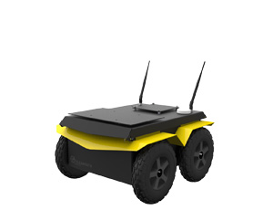
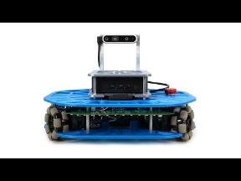
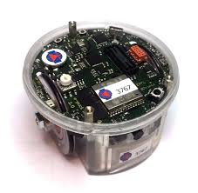
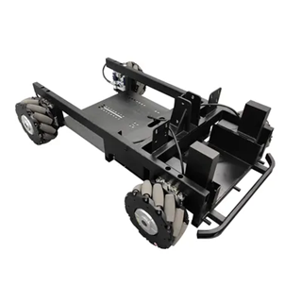
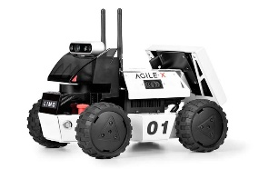
Image | Robot | Manufacturer & Origin | Perception & Sensors | Interface & Control | Secondary Dev. Support | Approx. Cost in India
 | TurtleBot3 | ROBOTIS (South Korea) | LiDAR, IMU, optional depth camera | ROS, OpenCR board, Gazebo simulator | Excellent online docs + ROS tutorials | ₹80k–1.2 lakh
 | Jackal UGV | Clearpath Robotics (Canada) | GPS, IMU, wheel encoders, optional 3D LiDAR & cameras | Full ROS/MoveIt, RViz, joystick, API | SDKs, detailed ROS packages | ₹16–22 lakh
 | Robotont | Tallinn Univ. of Technology (Estonia) | Depth camera, wheel odometry, IMU | ROS2, Python, onboard Jetson-ready | Full ROS2 tutorials & Gazebo models | ₹3.5–5 lakh
 | E‑puck2 | GCtronic (Switzerland) | IR sensors, light, IMU, camera, mic, proximity | Web GUI, Bluetooth/USB, remote control | C API, Webots/ROS2 simulation | ₹1.5–2 lakh
 | RoboCT | RoboCT, China | LiDAR, IMU, camera support | ROS, TCP/IP, Jetson/Nano support | ROS SDKs, Ubuntu-based control | ₹3–3.8 lakh
 | LIMO (Alibaba) | AgileX Robotics, China | LiDAR (Lite), IMU, camera (optional) | ROS, WebUI, joystick + PC-based control | Python SDKs, ROS1/2, Gazebo integration | ₹1.9–2.5 lakh
Mobile Robot

Slide 5
Rank | Robot | Performance | Interface & Control | Secondary Dev. Support | Cost (₹ INR) | Overall Rating (★ out of 5)
1 | Jackal UGV | ★★★★★ (Rugged/Outdoor) | Full ROS/MoveIt, RViz, joystick | SDKs, ROS, detailed packages | ₹16 – ₹22 L | ★★★★★
2 | TurtleBot3 | ★★★★☆ (Versatile/Edu) | ROS, OpenCR, Gazebo | Excellent docs, vibrant ROS | ₹80k – ₹1.2 L | ★★★★☆
3 | Robotont | ★★★★☆ (Research-Ready) | ROS2, Python, Jetson-ready | Full ROS2 integration | ₹3.5 – ₹5 L | ★★★★☆
4 | LIMO | ★★★★ (Multi-mode) | ROS, WebUI, joystick, PC control | ROS1/2, Gazebo integration | ₹1.9 – ₹2.5 L | ★★★★
5 | Bobile-B | ★★★ (Entry ROS Base) | ROS, TCP/IP, Jetson/Nano | ROS SDKs, Ubuntu-based | ₹3 – ₹3.8 L | ★★★☆
6 | E-puck2 | ★★☆ (Swarm/Edu level) | Web GUI, USB, remote control | C API, Webots, ROS2 sim | ₹2.5 – ₹3 L | ★★☆
Mobile Robot

Slide 6
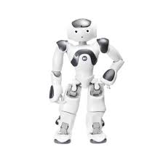
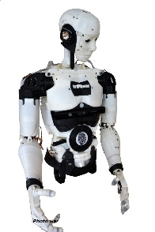
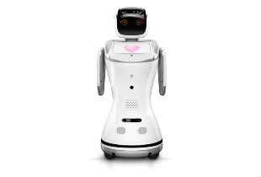
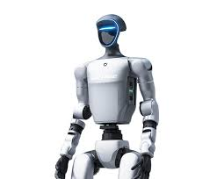
Image | Robot | Manufacturer & Origin | Perception & Sensors | Interface & Control | Secondary Dev. Support | Approx. Cost in India
 | NAO V6 | SoftBank Robotics (France/Japan) | 2 HD cameras, 30 sensors, 4 mics, IMU | NAOqi OS; Choregraphe; SDKs (Python/C++) | Excellent; vibrant community, extensive docs | ₹8,59,000
 | InMoov | France | Very High/ open source | MyRobotLab GUI, REST APIs, serial via Arduino | PC-based (Windows/Linux), ROS-enabled if extended | ₹10.2L-11.5L
 | Sanbot Elf (Qihan Technology) | China Expert Hub Robotics Solutions | HD camera, 3D depth camera | Sanbot Cloud SDK, APIs | Proprietary + Android-based modules | ₹10L – ₹12.5L
 | Unitree G1 / H1 | Unitree (China) | Vision, joint sensors | ROS‑compatible; C++/Python support | Good; open‑source drivers, affordable | ₹13–80 L
Humanoid Robot

Slide 7
Rank | Robot | Performance | Interface & Control | Secondary Development Support | Cost (₹ INR) | Overall Rating (★ out of 5)
1 | NAO V6 | ★★★★☆ (High) | NAOqi OS, SDKs (Python/C++) | Excellent, large dev community | ₹1.59 L | ★★★★★
2 | InMoov | ★★★★☆ (Flexible/Open) | MyRobotLab, REST APIs, Arduino | PC/ROS-enabled, community-driven | ₹1.2 L – ₹1.5 L | ★★★★☆
3 | Unitree G1/H1 | ★★★★ (Fast/Agile) | ROS-compatible, C++/Python | Affordable, good open-source SDKs | ₹13 – ₹80 L | ★★★★
4 | Sanbot Elf | ★★☆ (Service level) | Sanbot Cloud SDK, APIs | Proprietary, Android-based | ₹10 – ₹12.5 L | ★★☆
Humanoid Robot

Slide 8
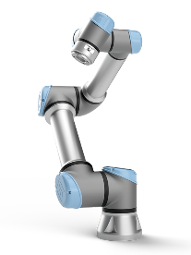
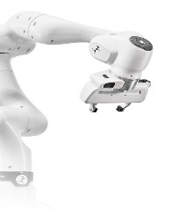
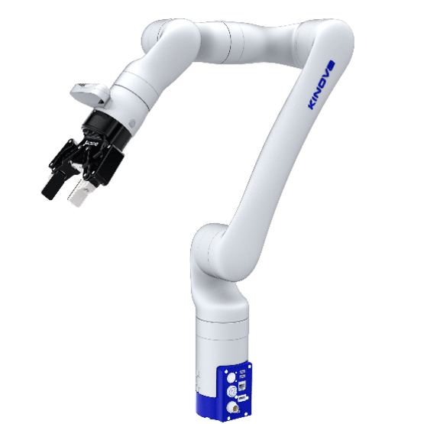
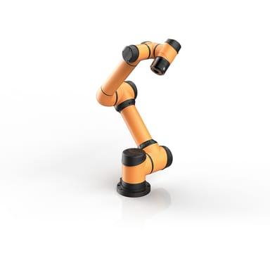
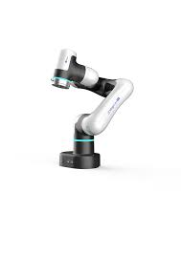
 | Robot | Manufacturer & Origin | Perception & Sensors | Interface & Control | Secondary Dev. Support | Approx. Cost in India
 | UR5e | Universal Robots, Denmark | Force-torque sensor, I/O sensors | Polyscope GUI, ROS, Python, Modbus, PROFINET | Extensive SDK, ROS/MoveIt support | ₹22–25 lakh
 | Franka Emika R3 | Franka Emika, Germany | Joint torque sensors, optional vision kits | Web GUI, ROS, low-level torque APIs | Open-source Python/C++ SDK | ₹35–45 lakh
 | Kinova Gen3 | Kinova Robotics, Canada | Torque sensors on all joints, vision add-ons | Kinova API, ROS, MoveIt, Python, C++, MATLAB | SDKs, ROS 1/2, healthcare apps | ₹25–30 lakh
 | AUBO i5s | AUBO Robotics, China | Basic I/O ports, external sensor support | Teach pendant, TCP/IP, Modbus, ROS | C++, Python, Lua, ROS SDKs | ₹10–12 lakh
 | DOBOT Magician E6 | DOBOT, China | Basic limit switches, external vision module | DobotStudio Pro (Block/Script), API for C/Py | Educational kits, Blockly support | ₹1.5–3 lakh
Manipulators Robot

Slide 9
Rank | Robot | Performance | Interface & Control | Secondary Dev. Support | Cost (₹ INR) | Overall Rating (★ out of 5)
1 | UR5e | ★★★★☆ (Industrial) | Polyscope GUI, ROS, Python, etc. | Extensive SDK, ROS/MoveIt | ₹22 – 25 L | ★★★★★
2 | Franka Emika R3 | ★★★★☆ (Advanced) | Web GUI, low-level APIs | Open-source SDK | ₹35 – 45 L | ★★★★☆
3 | Kinova Gen3 | ★★★★ (Precision) | Kinova API, ROS, MATLAB, etc. | SDKs, ROS 1/2, healthcare | ₹25 – 30 L | ★★★★☆
4 | AUBO i5 | ★★★ (Basic Industrial) | Teach pendant, TCP/IP, ROS | C++, Python, ROS SDKs | ₹10 – 12 L | ★★★☆
5 | DOBOT Magician E6 | ★★☆ (Educational) | Blockly/Script GUI, APIs | Educational kits, Blockly | ₹1.5 – 6 L | ★★☆
Manipulators Robot

Slide 10
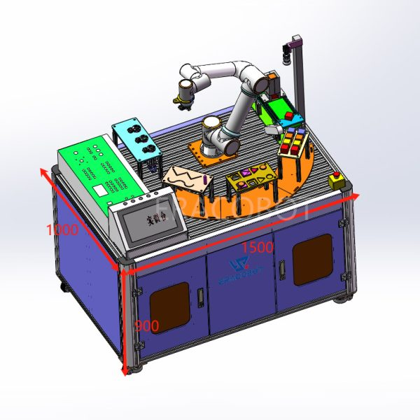
AI & Vision Systems & Various Manipulator
ERACOBOT: ERA‑M5 Cobot Education Platform
Website : https://eracobot.com/product/top-3-cobot-education-platform/

Slide 11
S.No. | Manufacturing Company | Cobot Used | Applications | Secondary Development Support | Approx. Price (INR)
1 | ERACObot (China) | ERA‑M5 | Pick-and-place, screw sorting, palletizing, vacuum handling, welding, vision | SDKs for C/C++, Python, Java, ROS; Web UI; teach pendant; training manuals/videos | ₹12.5 lakh
2 | ERACObot (China) | ERA‑M5 | Motion tracking with CCD camera; visual positioning; AI-powered object detection | Open vision API, real-time recognition tools, modular add-ons | Included in Top‑3 bundle
3 | ERACObot (China) | ERA‑M5 | STEAM education, university research, industrial prototyping | Teach pendant (optional), full integration with Modbus, TCP/IP, PROFINET protocols | ₹13.9 lakh (discounted)

Slide 12
Simulation & Control Software
Tool | Purpose
Gazebo / Webots / CoppeliaSim | Robot simulation with physics engine
MATLAB/Simulink | Control system design, kinematic modeling
ROS (Robot Operating System) | Middleware for robot communication and control
MoveIt / Rviz | Motion planning and visualization for manipulators

Slide 13
Sensor
Sensor | Application
LIDAR (RPLIDAR, Hokuyo) | Obstacle detection, SLAM
IMU (Inertial Measurement Unit) | Robot pose estimation
Encoders | Motor control feedback
Ultrasonic / IR Sensors | Proximity sensing, obstacle avoidance
All the sensors required for developing the systems should be added

Slide 14
CONTROLLERS
Robot (Controller) | Manufacturer & Origin | Perception & Sensors | Interface & Control | Secondary Dev. Support | Approx. Cost in India
Arduino UNO | Arduino.cc, Italy / Open Source | Supports analog/digital sensors via GPIO | C/C++ via Arduino IDE, simple serial interface | Massive online community, kits | ₹500–₹1,000
Raspberry Pi 4 | Raspberry Pi Foundation, UK | USB camera, IMU, GPIO sensors, AI peripherals | Python, Linux, SSH/VNC, OpenCV, GPIO | Excellent docs, ROS supported | ₹4,500–₹8,000
PLC (Siemens Logo) | Siemens, Germany | Industrial sensors via analog/digital I/O | Ladder Logic, SCADA/HMI, Siemens TIA Portal | Industrial training, certification | ₹20,000–₹50,000+
ESP32 | Espressif Systems, China | WiFi/Bluetooth, GPIO, analog sensors, cloud IoT | Arduino IDE, MicroPython, Web-based control | IoT libraries, large maker community | ₹300–₹700
Jetson Nano | NVIDIA, USA | RGB/Depth cameras, IMU, AI accelerators | Ubuntu + Python, CUDA, TensorFlow, ROS | AI/ML SDKs, ROS + CV ready | ₹9,000–₹12,000

Slide 15
Support Tools
Tool | Use
3D Printer (FDM/Resin) | Custom robot parts prototyping
Laser Cutter / CNC Machine | Hardware design & chassis development
Data Acquisition Systems (DAQ) | Real-time data logging and analysis
Battery Testing Station | For mobile robotics power systems

Slide 16
Thank you…

